Slide 1


K.RAMAKRISHNAN COLLEGE OF TECHNOLOGY
(AUTONOMOUS), TRICHY
Multi-Format Cyber Deception Detection
BATCH - 7
PRESENTED BY GUIDED BY
OVIYA P (2403811724322072) Mr. R. ROSHAN JOSHUA,M.E.,(Ph.D).,
RISHI P S (2403811724321092)
SATHISHKUMAR P (2403811724321102)
SHARMILA N (2403811724322107)
Assistant Professor / AI

Slide 2
PRESENTATION OVERVIEW
Problem statement
Objective
Literature survey
Existing system
Architecture diagram
Proposed system
Modules
Conclusion
Future enhancement

Slide 3
PROBLEM STATEMENT
Phishing attacks increasingly use URLs, PDF/DOCX documents, and QR codes, making traditional URL-only detection systems ineffective.
Traditional blacklist and rule-based systems often fail to detect zero-hour and obfuscated phishing attacks.
Lack of multi-format, real-time, and explainable detection can lead to credential theft, financial loss, and poor security decision-making.

Slide 4
OBJECTIVE
• To develop a unified phishing-detection system that analyzes URLs, PDF/DOCX documents, and QR codes using semantic similarity and heuristic-based detection techniques.
• To improve phishing detection by providing real-time, lightweight, and explainable threat analysis that identifies Safe, Suspicious, and Phishing inputs while supporting effective security decision-making.

Slide 5
LITERATURE SURVEY
Research papers

Slide 6
EXISTING SYSTEM
• URL-only detection — Cannot analyze phishing links hidden inside PDFs, DOCX files, or QR codes.
• Blacklist-dependent detection — Struggles to identify zero-hour and previously unseen phishing URLs.
• Limited analysis — Does not combine semantic similarity with multiple security heuristics.
• Poor explainability — Provides limited insight into why a URL is classified as malicious.
• Limited deployment — Many advanced models are computationally heavy and GPU-dependent.

Slide 7
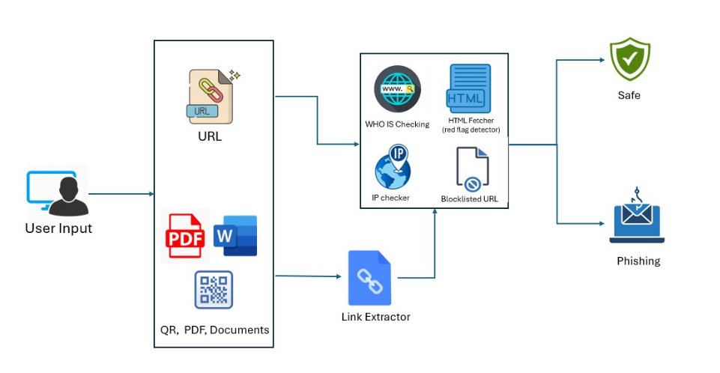
ARCHITECTURE DIAGRAM

Slide 8
PROPOSED SYSTEM
Multi-format phishing detection for URLs, PDF, DOCX, and QR-code inputs.
Extracts embedded links and converts them into a common format for analysis.
Combines semantic similarity and heuristic analysis to detect known and zero-hour phishing threats.
Provides explainable classification as Safe, Suspicious, or Phishing with the specific triggered signals.
Lightweight and CPU-based, enabling real-time detection without GPU dependency.

Slide 9
MODULES
Input Acceptance & Routing Module
Format-Specific Link Extraction Module
Hybrid Detection & Analysis Module
Explainable Report & Dashboard Module

Slide 10
MODULES
Input Acceptance & Routing Module:
Accepts URLs, PDF files, DOCX documents, QR-code images, and HTML text.
Identifies the input format and routes it to the appropriate processing module.
Converts different input types into a common URL representation for analysis.

Slide 11
MODULES
2. Format-Specific Link Extraction Module:
Extracts embedded links from PDF, DOCX, and QR-code inputs.
Uses PyMuPDF, python-docx, and pyzbar for format-specific extraction.
Normalizes all extracted URLs before sending them to the detection engine.

Slide 12
MODULES
3. Hybrid Detection & Analysis Module:
• Performs semantic similarity analysis using a lightweight transformer model.
• Checks domain age, IP usage, redirections, blacklist status, and suspicious HTML.
• Combines both analysis scores to classify inputs as Safe, Suspicious, or Phishing.

Slide 13
MODULES
4. Explainable Report & Dashboard Module:
Displays the final threat classification and risk score.
Shows which specific security checks triggered the detection.
Provides a simple, explainable Gradio interface for analysts and users.

Slide 14
CONCLUSION
The proposed multi-format phishing detection system provides a unified approach for detecting threats across URLs, PDF, DOCX, and QR-code inputs.
Semantic and heuristic analysis improves detection of both known and previously unseen phishing attacks.
Explainable, lightweight detection enables faster security analysis and supports informed decision-making without GPU dependency.
Notes:
‹#›

Slide 15
FUTURE ENHANCEMENT
Integration with advanced threat intelligence for improved phishing detection.
Support for additional file formats such as HTML, XLSX, and PPTX.
NLP-based analysis of document and QR-code content for deeper threat detection.
Microservice API integration to connect the detection engine with other security tools.

Slide 16
THANK YOU

